Slide 1

Underwater image dehazing and enhancement using Deep learning techniques
Presented By, | Under the guidance of, Mrs. Ammu Bhuvana D, Asst. prof, Dept. of CSE, EPCET
Sanjay P ( 1EP19CS104 )
Kiran TR ( 1EP19SC043)
Kaushik Choudhury (1EP19CS038)
Narahari Prasad B S (1EP19CS057)

Slide 2
INTRODUCTION
Domain
Artificial intelligence and machine learning
Artificial intelligence is the way of making a computer-controlled robot, or software think intelligently.
Ex:- siri, google,alexa are examples of ai
Machine learning is a branch of the field of ai that makes use of statistical models to develop predictions
It mainly uses algorithms that take data in, analyze it, and generate output based on analysis
In some approaches, algorithms work with so-called "training data“ first and then they learn, predict,and find ways to improve their performance overtime

Slide 3
TITLE[UNDERWATER IMAGE DEHAZING AND ENHANCEMENT USING DEEP LEARNING TECHNIQUES]
Underwater imaging is a major concern for all researchers, the main reason for it is the physical properties that are present in the underwater environment affect the images captured by the visual sensors.
As a consequence of these properties, the captured image includes non-uniform illumination
This non-uniform illumination causes colour distortion, low contrast, white regions, and colour casts.
An underwater image enhancement method is proposed by combining a colour constancy framework and dehazing.

Slide 4
Problem Statement
Underwater images captured by cameras are plagued with poor contrast and distortion, which results in scattering and absorptive properties of water.
Underwater robots play an important role in oceanic geological exploration, resource exploitation, ecological research, and other fields.
The other major use of underwater images is to understand marine life, but due to the distorted images, we may encounter a lot of errors in it.
The recent advancements in underwater exploration have led people to develop an interest in marine life and underwater photography.

Slide 5
This demand has created a huge demand for producing quality underwater images without any distortions but, due to the very less availability of methods and platforms to achieve such quality it has people concerned.
Underwater photography for personal use is also a trending field in recent times, recent advancements have led to a dramatic increase in underwater photography,
but due to the lack of quality images and the heavy requisites for getting a very less distorted image, the market has compromised the quality and has started to decline.
Hence it is necessary to develop a method that can overcome these issues and provide accurate data. So we take this opportunity in developing this project where we develop a platform where people can get their distorted or hazy images dehazed and with better quality.

Slide 6
Literature Survey
Author | Title | Year | Description | Merits | Demerits
Farhan Hussain and Jechang Jeong | Visibility Enhancement of Scene Images Degraded by Foggy Weather Conditions with Deep Neural Networks | 2015 | The modeluses deep neural networks to dehaze the images | Restored images (dehazed images )showed better quality | The method accuracy was less and the model failed to reproduce exact details
Mayuri Madake Sankirti Shiravale | Image Dehazing of Images Captured in Real-World Weather Conditions using Derived Guided Filter | 2018 | The model uses Derived guided filter based visibility restoration approach along with dark channel prior | Provides better edge preservation in comparison than previous methods | Not applicable in real-time with increased parameters
R. Suganya R.Kanagavalli | Hybrid gated recurrent unit and CNN based Deep learning architecture-based visibility improvement scheme for improving fog-degraded images. | 2021 | It’s a hybrid system that is developed by using deep learning and CNN and GRU. The GRU handles the noise, the CNN for spatio-temporal data matrices for converting vectors . | Its results were proved to be very efficient and the time to process the image was the fastest among all the others models. It can be implemented in real-time. | It requires tremendous computing power and faster GPUs which result in a very expensive setup and demands a lot of resources.

Slide 7
Author | Title | Year | Description | Merits | Demerits
Simon Emberton, Lars Chittka, Andrea Cavallaro | Underwater image and video dehazing with pure haze region | 2018 | The paper proposes a model that has an improvised dark channel prior method where the image data is taken and its physical attributes are enhanced and then it is subjected to dark prior method. | The results proved to be very efficient compared to the previously existing models. | The method showed signs of incorrect estimation of the transmission map in scenes that contain bright objects.
Chaitra Desai Badduri Sai Sudheer Reddy Ramesh Ashok Tabib Ujwala Patil Uma Mudenagud | AquaGAN: Restoration of Underwater Images | 2018 | The main focus of the paper was to restore the images that are captured underwater using GAN(Generative adversarial network) method using 2 encoder and decoder method for image restoration. | Images of infinite depth between camera and scene can be recovered regardless of the light intensity | Does not alter the hazed images
Zheng Liang Yafei Wang Xueyan Ding Zetian Mi Xianping Fu | Single underwater image enhancement by attenuation guided by color correlation and detail preserved dehazing | 2020 | The paper focuses on image enhancement using color correlation and attenuation map guided color distortion | This method has produced exceptional accuracy and detailed images compared to previous methods. | Due to its depth detailing, the image processing gets delayed and requires huge computing power.

Slide 8
Existing System
The dark channel prior is derived from the characteristics of natural outdoor images that the intensity value of at least one colour channel within a local window is close to zero.
Based on the dark channel prior, the dehazing is accomplished through four major steps: atmospheric light estimation, transmission map estimation, transmission map refinement, and image reconstruction.
Guided filter: A Guided filter is an edge-preserving smoothing light filter.

Slide 9
Existing System Advantages
Guided image filter perform well in terms of both quality and efficiency in a wide variety of applications such as noise reduction.
Guided image filters are mainly used for edge detection which uses an edge- preserving smoothing filter for detecting the edges.
Input images uses the content of the second image called the guidance image.
The experimental analysis on dark channel prior-based methods will help readers understand the effectiveness of the individual step of the dehazing process and will facilitate the development of advanced dehazing algorithms.

Slide 10
Limitations Of Existing System
Sometimes the loss function extracts high-level functions resulting in increased computing time.
Models often return garbage values in real-time as they are only subjected to synthetic images and not real images.
Dark prior method has incorrect estimation from the transmission map when there are bright objects.
Object detection is efficient but due to loss of actual data from the image, the accuracy gets affected in underwater image, the accuracy gets.

Slide 11
Proposed System
In the proposed system, we subject the distorted/ hazy images to the following methods.
Colour constancy
White balance
Chromatization
Dehazing using Channel intensity prior
Transmission map
Edge smoothing
Texture smoothing
Gamma correction(after each phase, convert RGB image to Hyperspectral image along with gamma correction)

Slide 12
Objectives
To develop a system that can be embedded in deep-sea remotely operated vehicles.
To enhance the quality of the images taken by divers.
To improve oceanic research capabilities by providing quality images.
To enhance images that are taken by commoners who go for dive or for pre-wedding shoots underwater.
To improve the study of deep-sea tectonic activities.
To develop ways to travel deep under the ocean with fewer barriers.
To develop a system that can also be used in other conditions with similar problems.

Slide 13
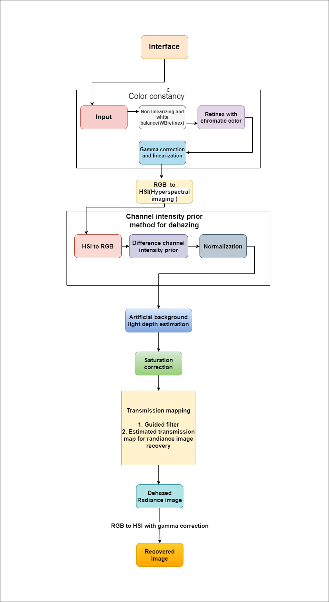
Proposed Architecture

Slide 15
Conclusion
In this approach, we used Color constancy, Dehazing using Channel intensity prior, transmission maps, and gamma correction.
Here in our approach, we have multiple advantages, such as faster computing and real-time application of the system.
People can access the system across various platforms as its requisites are very less.
Applications of this can even be used in case of fog, haze, and dust-degraded images.
The method serves its main aim in assisting oceanic research and marine life exploration.
It can also benefit travelers and photographers who are often annoyed by the disturbances in their images due to the conditions.
The method can get be further used in various cases for various purposes, such as in cars when the road is foggy, and in dusty areas while traveling and it can also be implemented to remove haze from satellite images.

Slide 16
References
Chaitra Desai Badduri, Sai Sudheer Reddy, Ramesh Ashok Tabib, Ujwala Patil Uma, Mudenagud- AquaGAN: Restoration of Underwater Images(2018)
Farhan Hussain and Jechang Jeong: Visibility Enhancement of Scene Images Degraded by Foggy Weather Conditions with Deep Neural Networks(2015)
Mayuri Madake Sankirti Shiravale: Image Dehazing of Images Captured in Real-World Weather Conditions using Derived Guided Filter(2018)
R. Suganya R.Kanagavalli: Hybrid gated recurrent unit and CNN-based Deep learning architecture-based visibility improvement scheme for improving fog-degraded images.(2021)
Simon Emberton, Lars Chittka, Andrea Cavallaro: Underwater image and video dehazing with pure haze region(2018)
Zheng Liang, Yafei Wang, Xueyan DingZetian Mi, Xianping Fu: Single underwater image enhancement by attenuation guided by color correlation and detail preserved dehazing(2020)

